Slide 1
Important terminologies
State/Country: refers to a large nation with its own government and economy.
Administrative units: An administrative division, unit, entity, area or region, also referred to as a subnational entity, constituent unit, or country subdivision, is a portion of a country or other region delineated for the purpose of administration. (Federal Form of Govt. )( Unitary form of Gov.)
Administrative units of Pakistan. The administrative units of Pakistan consists of four provinces (Balochistan, Khyber Pakhtunkhwa, Punjab, Sindh), two autonomous territories (Azad Jammu and Kashmir and Gilgit Baltistan) and one federal territory (Islamabad Capital Territory).
Constitution: a body of fundamental principles or established precedents according to which a state or other organization is acknowledged to be governed.
Presidential form of Government : President as Head of the government Parliamentary form of Government: Prime minister as Head of the government(bi-cameral)
Theocracy: a system of government in which priests rule in the name of God or a god.
Cabinet : cabinet is a body of high-ranking state officials, typically consisting of the top leaders of the executive branch. They are usually called ministers, but in some jurisdictions are sometimes called secretaries.

Slide 2
Important terminologies
Republic: a form of government in which the country is considered a "public matter", not the private concern or property of the rulers.
President: Head of the State
Prime minister: Head of the Government
Pillars of government: Executive (implementation): Legislative (Law making) :Judiciary (Check Balance)
Bicameral system of government : Upper house (Senate) and Lower House(National Assembly) ..collectively called as parliament.
Senate 104
National Assembly 342
P 174
S 75
KPK 60
B 20
ICT 3
How the billed is passed in parliament?
1Signed by NA
2Signed by Senate
3Signed by President
4Become an ACT

Slide 3
Important terminologies
Secularism: secularism is the principle of the separation of government institutions and persons mandated to represent the state from religious institution and religious dignitaries (the attainment of such is termed secularity).
Liberalism: Liberalism is a political and moral philosophy based on liberty, consent of the governed and equality before the law
Westernization: the social process of becoming familiar with or converting to the customs and practices of Western civilization.
Types of Political Parties:
Someone who is right-wing in politics is usually someone who supports social or economic conservatism. In other words, someone who is "right-wing" usually supports tradition and the way things are.
Left-wing politics supports social equality and egalitarianism, often in opposition to social hierarchy

Slide 4
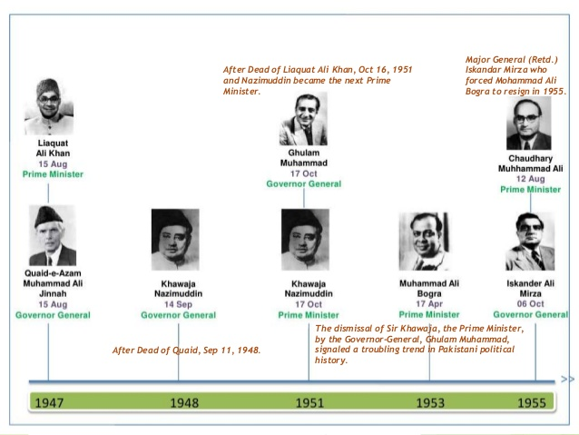
First Democratic Interlude (1947-1958)

Slide 5
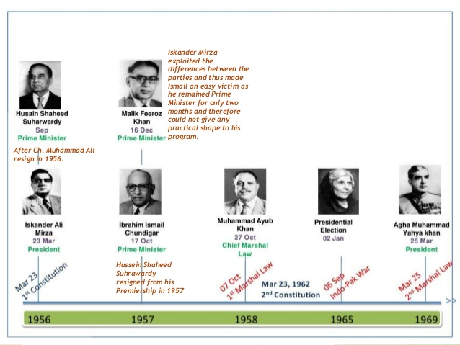
First Democratic Interlude (1947-1958)

Slide 6
Khawaja Nazimuddin Becomes Governor General [1948-1951] When the founder of Pakistan, Quaid-i-Azam, Muhammad Ali Jinnah died on September 11, 1948, Nazimuddin was appointed as the second Governor General of Pakistan.
the Government of India Act of 1935 became, with certain adaptations, the working constitution of Pakistan. However, a Constituent Assembly was set up under the Independence Act. The Constituent Assembly had a dual purpose; to draft the constitution of Pakistan and to act as a legislative body till the new constitution was passed and enforced

Slide 7
Khawaja Nazimuddin becomes Prime Minister [1951-1953] Under Quaid-i-Azam's constitutional framework, executive powers lay with the Prime Minister. When Liaquat Ali Khan was assassinated on October 16, 1951, Khawaja Nazimuddin, who was the Governor General at that time, took over as the second Prime Minister of Pakistan. Ghulam Muhammad, who had been Finance Minister since the inception of Pakistan, was elevated to the post of Governor General.
It was under Prime Minister Khawaja Nazimuddin that the second draft of the Basic Principles Committee was presented to the Constituent Assembly on December 22, 1952. He remained in power till April 1953 when Ghulam Muhammad removed him from the office. Thus destroying the concept of impartiality by the governor general. The movement for Tahaffuz-i-Khatam-i-Nabuwat and the worsening food condition in Punjab caused a lot of trouble for Khawaja Nazimuddin. Maulana Abul Ala Moududi was ordered death sentence for writing “Qadiyani Masla”. This was later converted as life imprisonment.
Inquiery report of Liaqat Ali khan ‘s death was alleged to have been changed 37 paragraphs from 64 page reported was deleted for security reasons.
The anti-Ahmadiya movement was started in Punjab by the Ahrar. This movement soon spread to other parts of the country. There were widespread disturbances and the situation in the country soon worsened to the brink of anarchy and civil war. Imposition of 3 months Martial Law became imminent. Khawaja Nazimuddin was summoned by the Governor General along with his Cabinet and ordered to resign. Khawaja Nazimuddin declined but was dismissed by Malik Ghulam Muhammad on April 17, 1953. After the dismissal of Khawaja Nazimuddin, the Governor General appointed Muhammad Ali Bogra, an unknown person from East Pakistan, as the Prime Minister.

Slide 8
Language Controversy 1952
the language controversy was on forefront during this era,in January 1952 Prime Minister Khawaja Nazimuddin while visiting East Pakistan, announced that Urdu will be the national language of Pakistan. However East Pakistan Assembly passed a resolution to make Bengali the national language along with urdu. The issue was to continue simmering for another two years, when in 1954 the constituent assembly declared Bengali the second national language.

Slide 9
Ghulam Muhammad becomes Governor General [1951] When Khawaja Nazimuddin took over as Prime Minister in 1951, Ghulam Muhammad was appointed as the Governor General. After coming to power, Ghulam Muhammad wanted to change the status quo of executive powers. To this end, in an undemocratic move, he dismissed the Prime Minister, Khawaja Nazimuddin in April 1953.
After dismissing Khawaja Nazimuddin, the Governor General appointed a leader from East Pakistan, Muhammad Ali Bogra, as the Prime Minister.
Ghulam Muhammad had also dissolved the Constituent Assembly although the Assembly had accomplished the task of framing the Constitution, and all obstacles in the way of its promulgation had been removed.

Slide 10
After coming to power, Bogra declared that the making of the Constitution was one of his primary targets.
A committee was set up to draft the constitution according to the approval of the Constituent Assembly. However, before the constitution could be finalized, Ghulam Muhammad dissolved the Assembly. The Prime Minster, Muhammad Ali Bogra was allowed to continue in office with a new cabinet. This move was apparently to counter a bill passed in the Assembly curtailing the powers of the Governor General. Muhammad Ali Bogra was sworn in again as the Prime Minister and it was promised that fresh elections would be held later on.
Malik Ghulam Muhammad was forced to retire from the post of Governor General due to his failing health and Major General Iskander Mirza, the Minister of Interior, took over the office on 7 august 1955

Slide 11
Chaudhry Muhammad Ali Becomes Prime Minister [1955] On August 8, 1955, Muhammad Ali Bogra was dismissed by the acting Governor General, Major General Iskander Mirza in the absence of Malik Ghulam Muhammad, who had gone on a temporary leave and was also subsequently forced to resign due to his ill health. Chaudhry Muhammad Ali was appointed as the new Prime Minister on August 11, 1955.
Ghulam Muhammad resigned as the Governor General formally on 19th sept 1955. on 7th oct 1955 Iskandar mirza was sworn in as a Governor General.
Chaudhry Muhammad Ali's greatest achievement was framing the Constitution of 1956 and its approval by the Constituent Assembly.
Chaudhry Muhammad Ali resigned as a Prime Minister on September 8, 1956, also resigning from his membership of the Muslim League at the same time.

Slide 12
Iskander Mirza Becomes Governor General [1955] In August 1955, Major General Iskander Mirza took over as Governor General when Ghulam Muhammad became too ill to continue. He was confirmed as the fourth Governor General of Pakistan on October 4, 1955.
Iskander Mirza was also a great advocate of the One Unit scheme and it was under his rule that all the four provinces and the states of West Pakistan were merged into one unit in October 1955. It was during his tenure that Chaudhry Muhammad Ali presented the 1956 Constitution and Iskander Mirza was elected the first President of Pakistan.

Slide 13
The One Unit Scheme
One-Unit was the title of a scheme launched by the federal government of Pakistan to merge the four provinces of West Pakistan into one homogenous unit, as a counterbalance against the numerical domination of the ethnic Bengalis of East Pakistan The One Unit policy was announced by Prime Minister Muhammad Ali Bogra on 22 November 1954. On 5 October 1955 Iskander Mirza (Acting Governor General of Pakistan) passed an order unifying all of West Pakistan in what became known as the 'One Unit Scheme'.
The West Pakistan Act
it was passed on 30th sept 1955 giving constitutional cover to the one unit scheme. Chief minister of new west Pakistan was Dr. Khan Sahib and Lahore was as Provincial Capital.

Slide 14
1956 constitution:
After assuming charge as Prime Minister, Chaudhry Muhammad Ali along with his team worked day and night to formulate a constitution for Pakistan. His efforts led to the first constitution that was enforced in the country on March 23, 1956. Pakistan’s status as a dominion ended and the country was declared an Islamic Republic of Pakistan. Thereupon the Constituent Assembly of Pakistan became the interim National Assembly and Governor General Iskander Mirza was sworn in as the first President of Pakistan.
The Constitution of 1956 consisted of 234 articles, which were divided into 13 parts and 6 schedules. One of the main features of the Constitution was its Islamic character. The Islamic provisions were contained in the directive principles of the state policy. Along with other Islamic provisions in the Constitution, the president, who was required to be a Muslim of at least 40 years of age, was to set up an organization for Islamic research with the aim of establishing a true Islamic society. The Objectives Resolution was, however, only made the preamble of the Constitution and not included in its main text.

Slide 15
H. S. Suhrawardy Becomes Prime Minister [1956] Soon after the adoption of the 1956 Constitution, Huseyn Shaheed Suhrawardy replaced Chaudhry Muhammad Ali as Prime Minister on September 12, 1956. President Mirza demanded the Prime Minister's resignation. Suhrawardy requested to seek a vote of confidence in the National Assembly, but this request was turned down. Suhrawardy resigned under threat of dismissal on October 10, 1957.

Slide 16
Martial Law Under Field Marshal Ayub Khan [1958-62] On October 7, 1958, President Iskander Mirza abrogated the Constitution and declared Martial Law in the country. This was the first of many military regimes to mark Pakistan's history. With this step, the Constitution of 1956 was abrogated, ministers were dismissed, Central and Provincial Assemblies were dissolved and all political activities were banned. General Muhammad Ayub Khan, the then Commander-in-Chief of the armed forces, became the Chief Martial Law Administrator. The parliamentary system in Pakistan came to end. Within three weeks of assuming charge on October 27, 1958, Iskander Mirza was ousted by General Ayub Khan, who then declared himself President.

